Slide 1
ENGI 301 SignTalk Project Proposal
September 25th, 2023
Diya Gupta

Slide 2
Background Information
Disabled people who cannot speak use sign language as one of their primary modes of communication. Because I do not understand sign language, in any encounters with such people I need the help of an interpreter to understand what they are saying. This discourages communication as it requires the non-speaking person to always have a 3rd person interpreter present along with them. Thus I wanted to create an electronic device that would track the symbols someone makes with their hands and output a word, phrase, or number on a screen that could be understood by those who have not learned sign language. I also wanted to include the component of hand movement and orientation for more complex signing. Because I will not have time to work with very complicated movements/signs, I will try to get my device to interpret the gesture of a number (drawing a number in the air). Signing uses both fingers and hand movements, and my goal with this project is to begin to interpret and translate these movements to output words and numbers. I have taken inspiration from these two projects:
https://www.hackster.io/sachin0987/handtalk-a-smart-handglove-interpreter-71fa7d
https://www.hackster.io/andrei-mitrofan/no-touch-gesture-calculator-40e7d4
The major improvement I want to incorporate is that I want to program some sort of timer system or a similar algorithm so that a person could sign individual letters to make a whole word. This allows for more flexibility and range in what someone is signing instead of a fixed number of specified signals. I also plan to incorporate a help/SOS function with a buzzer.

Slide 3
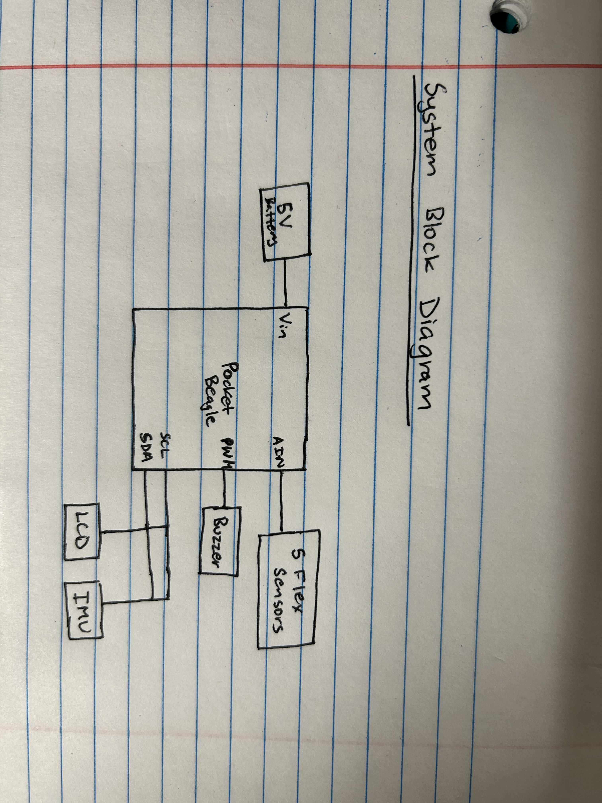
System Block Diagram

Slide 4
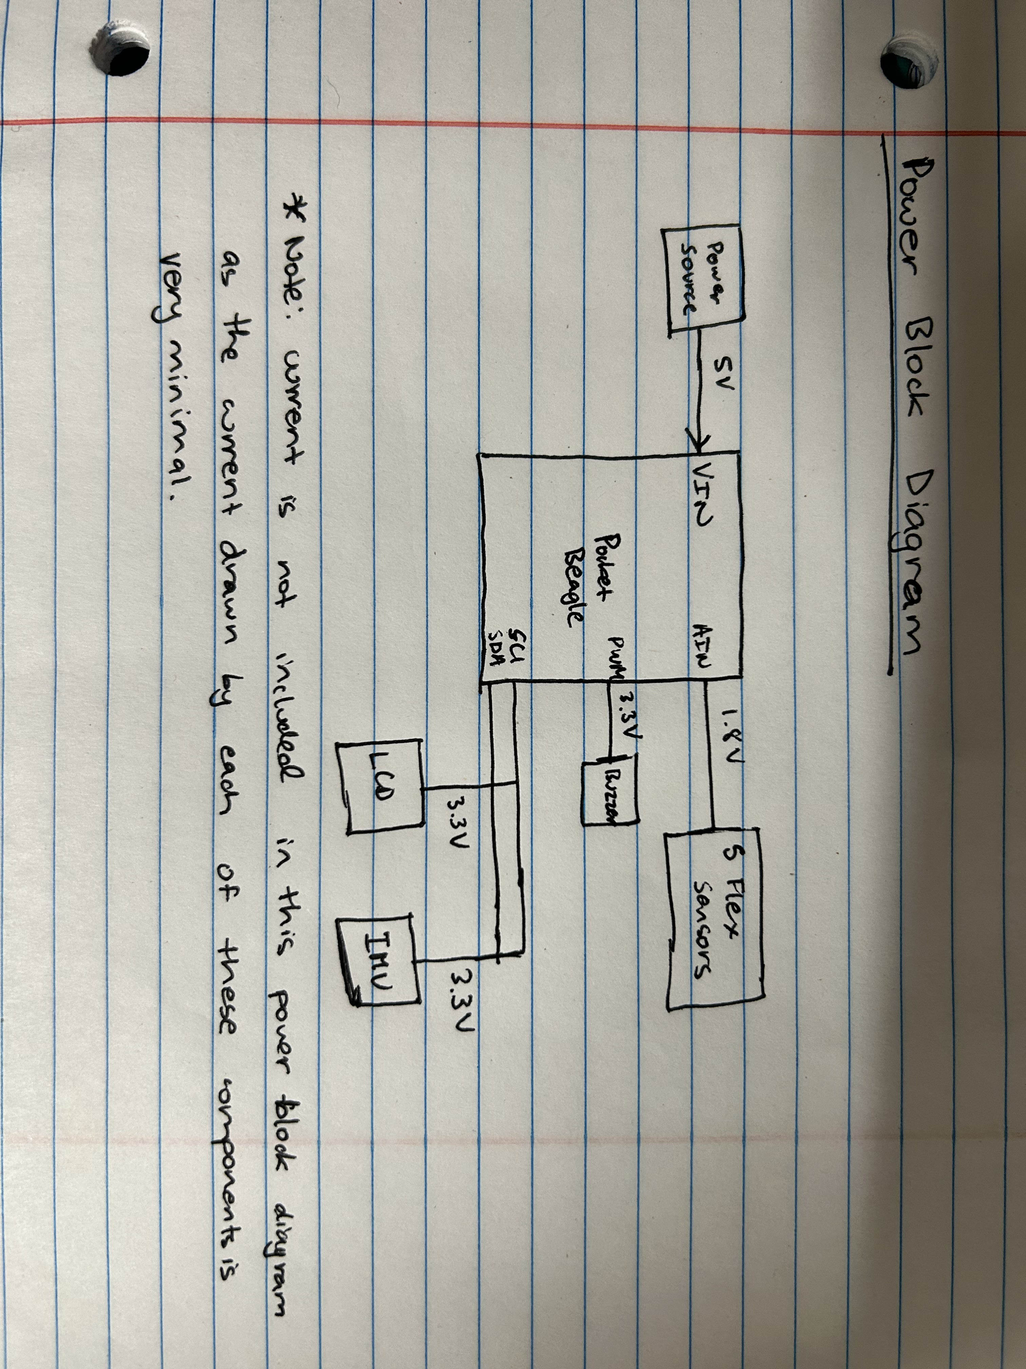
Power Block Diagram

Slide 5
Components / Budget
Component | Need to Buy | Cost
Flex sensors: https://www.adafruit.com/product/1070 | 5 | $8 each, $40 total
Buzzer: https://www.adafruit.com/product/1070 | 1 | $1
IMU: https://www.amazon.com/MPU-6050-MPU6050-Accelerometer-Gyroscope-Converter/dp/B07RXQGGJX?th=1 | 1 (comes in 6 pack) | $12 for 6
Small I2C Display: https://www.amazon.com/Pieces-Display-Module-SSD1306-3-3V-5V/dp/B08CDN5PSJ?th=1 | 1 | $14
Gloves: https://www.amazon.com/Cotton-Gloves-Handling-Inspection-Photography/dp/B07ZMXNCQ5/ref=sr_1_6?crid=155Q7L85N0RJN&keywords=cloth+glove&qid=1695700842&sprefix=cloth+glove%2Caps%2C100&sr=8-6 | 1 (pack of 3) | $7

